Slide 1



Slide 2
Proof of Picture
What is it?
Wat does it do?
What does it solve?
User Interface / User Experience

Slide 3
Proof of Picture
What is it?
PoP it = Proof of Picture
A mobile camera app
A Hash tool
A BCH Wallet to send Op_Return transactions

Slide 4
Proof of Picture
Wat does it do?
Creates photos
Creates Hash
Creates Op_Return transaction to bch blockchain
Include meta data such as GPS location or any other useful info
Creates Proof of Picture

Slide 5
Proof of Picture
Wat does it solve?
It provides extensive “Visual evidence” for lots of usecases

Slide 6
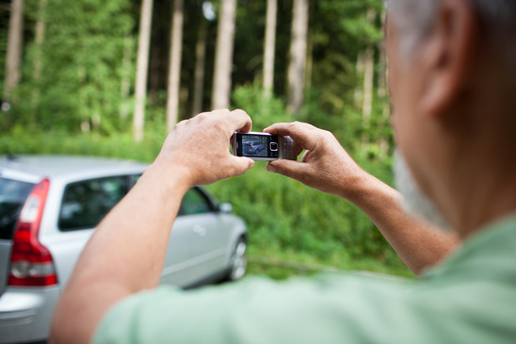
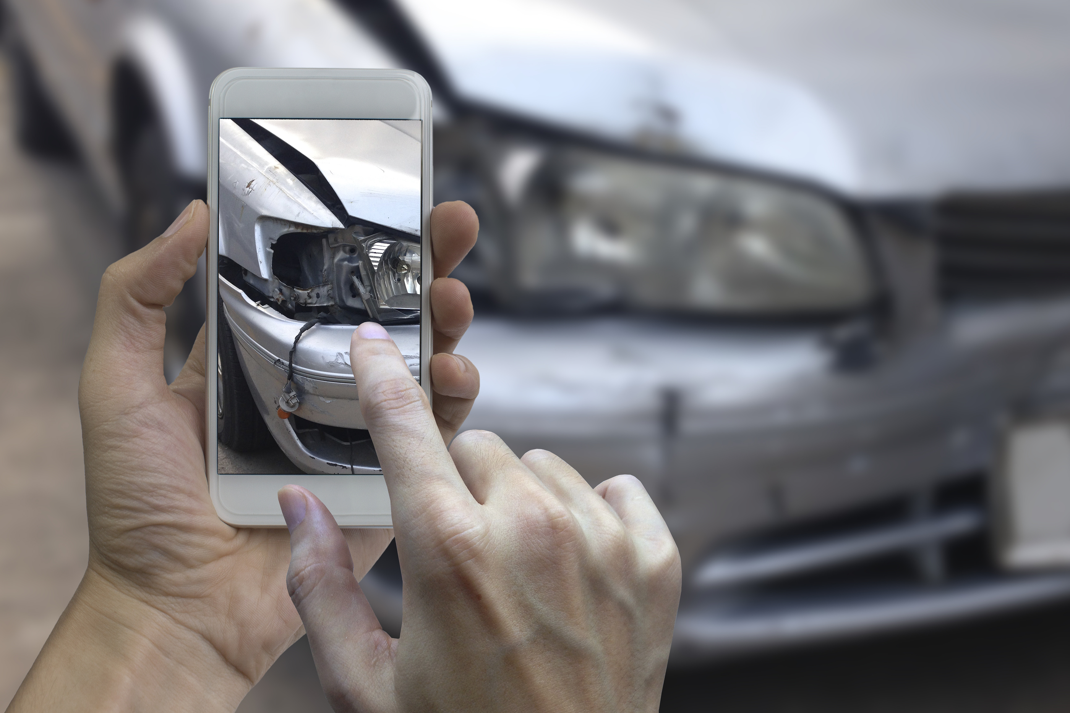
Proof of Picture
Car Insurance / Picking up a Rental Car
Claiming insurance
>

Slide 7
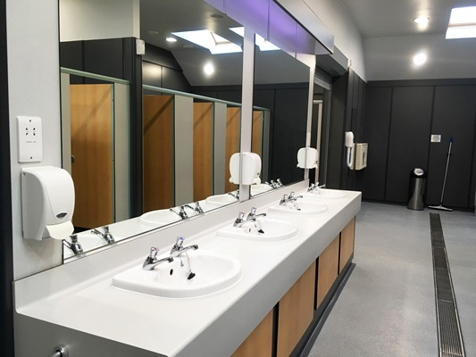
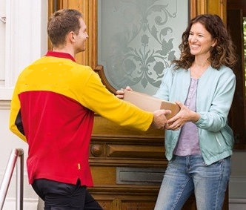
Proof of Picture
Proof that a task has been performed
>
>
Cleaning a restroom
Delivering a Parcel

Slide 8
Proof of Picture
And many more………………………………………

Slide 9
Proof of Picture
User Interface / User Experience

Slide 10
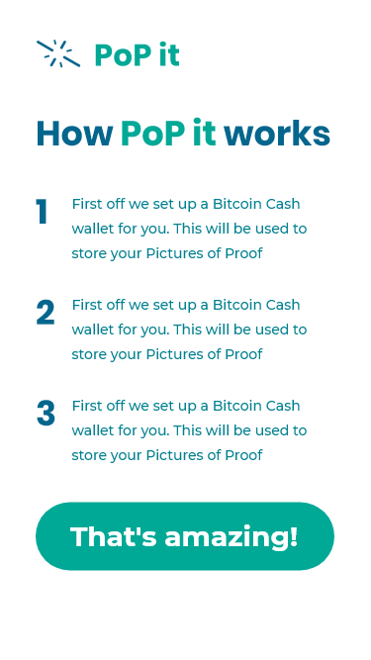
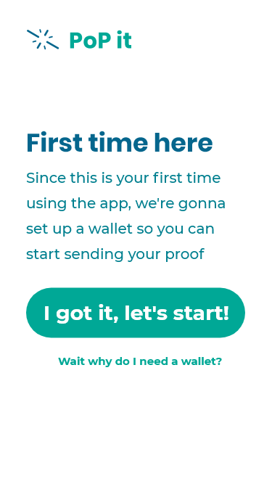

Proof of Picture
First time info

Slide 11
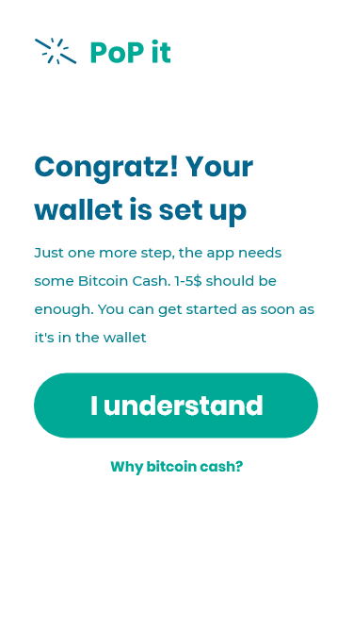
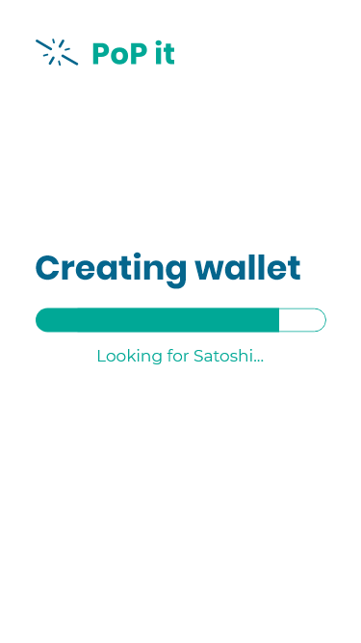
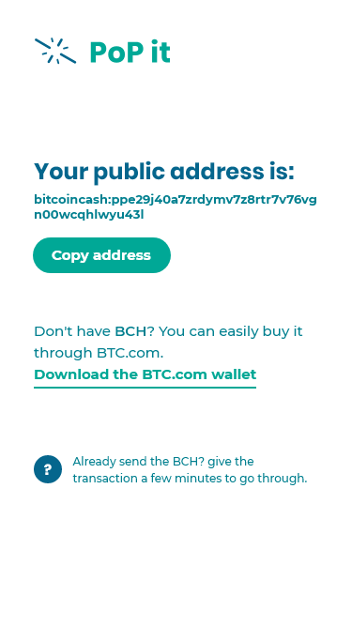
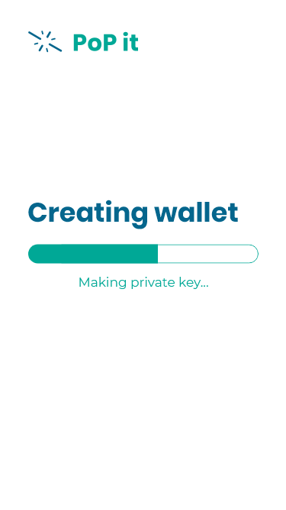

Proof of Picture
Setting Up wallet

Slide 12
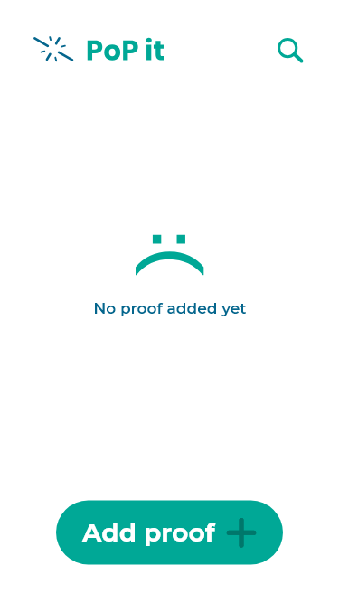
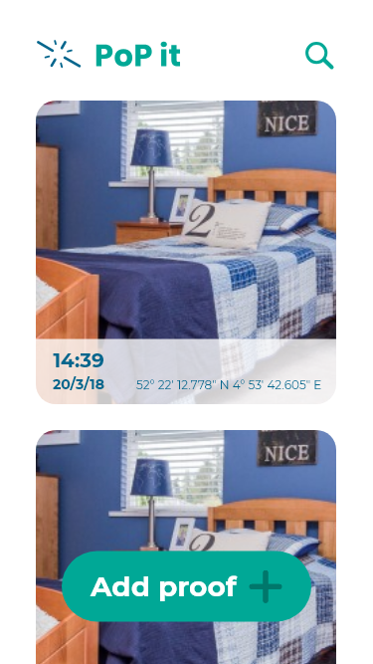
Proof of Picture
Using the App

Slide 13

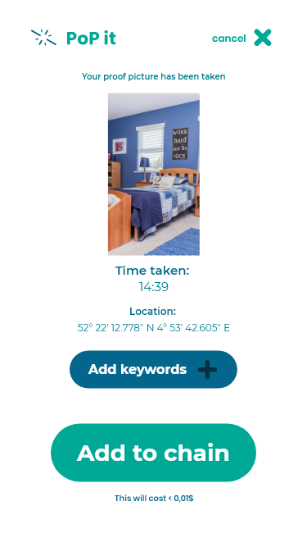
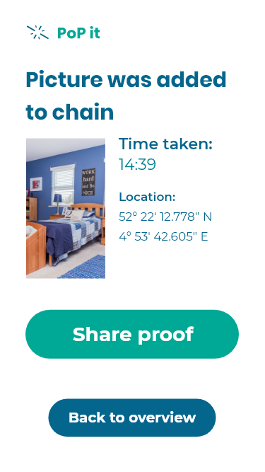

Proof of Picture
Using the App
>

Slide 14
Proof of Picture
What did we use?
> BitBox
> JavaScript & Node.JS
> GitHub

